Slide 1
Basic Details of the Team and Problem Statement
Problem Statement Title:
Team Name:
Team Leader Name:
Institute Name:
Sub Domain Name:
Network Traffic Analysis
AltF4
Raman Biju
Sandip University, Nashik
Cyber Security

Slide 2
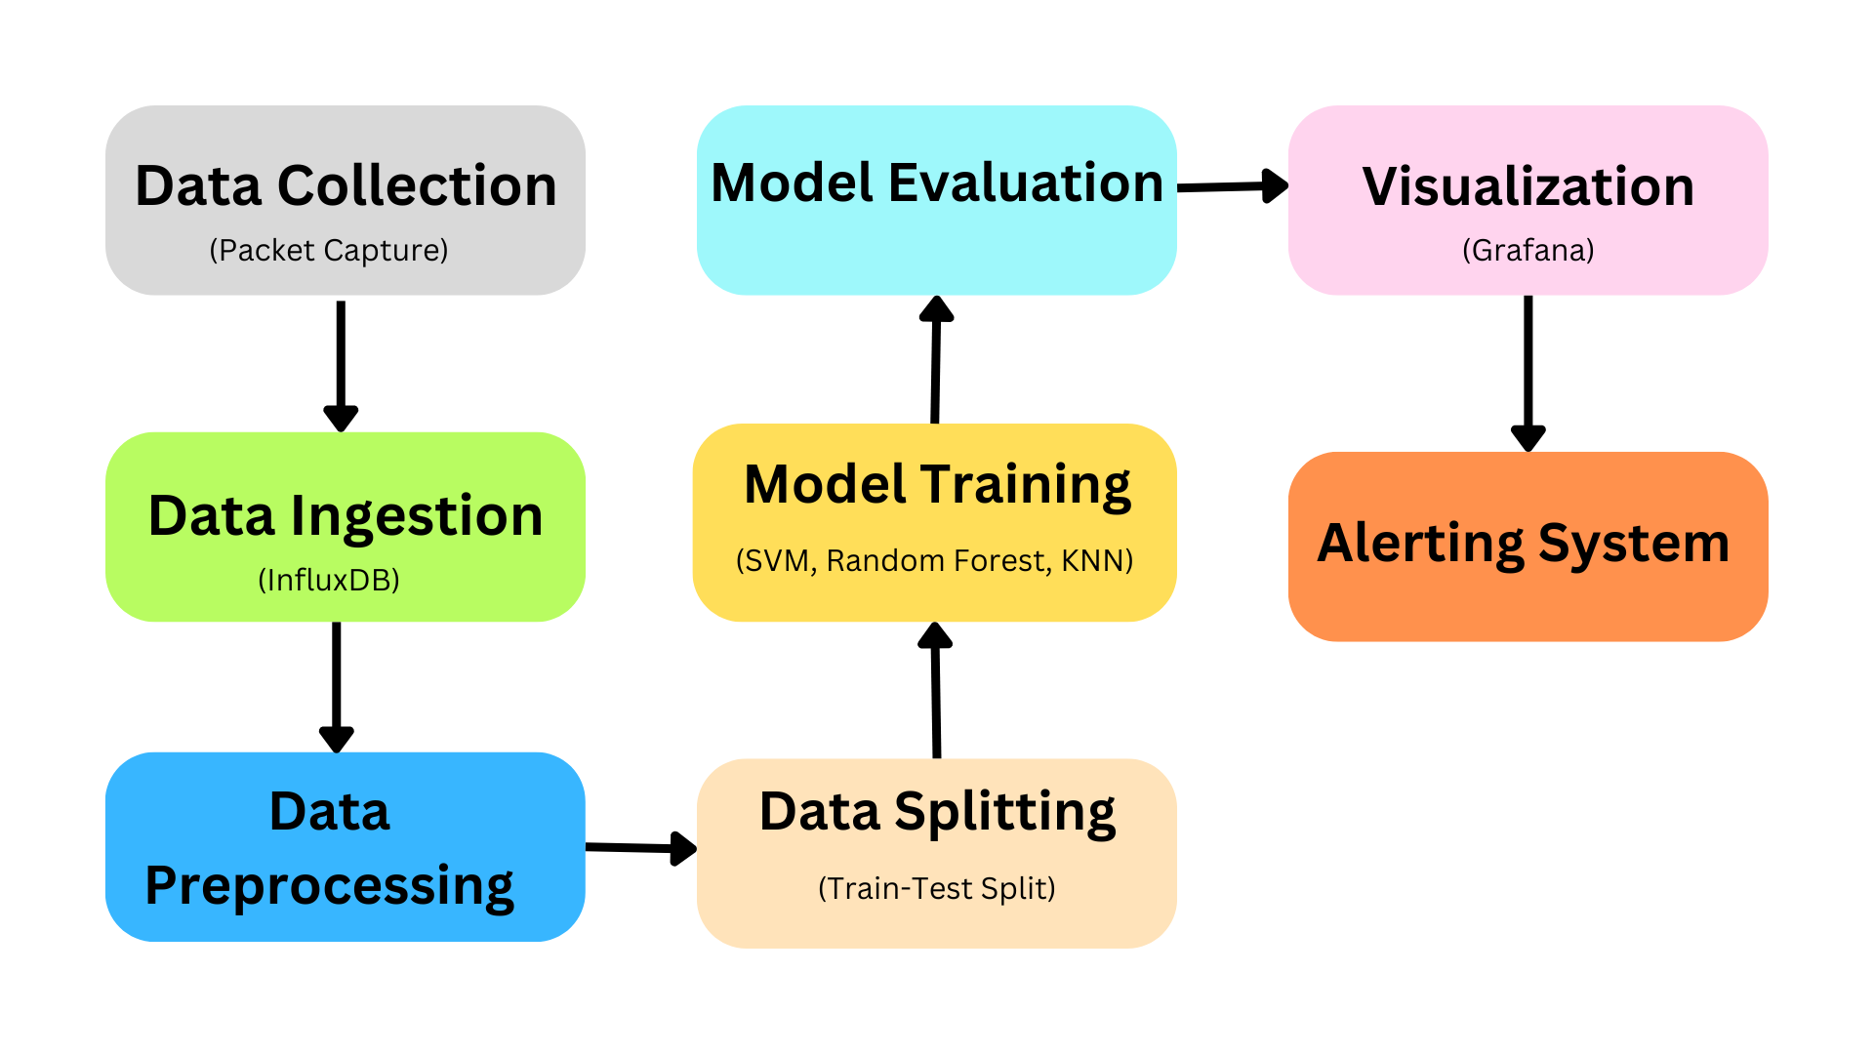










Idea/Approach Details
Technology Stack
Our project aims to revolutionize network security through advanced AI-driven traffic analysis. By integrating real-time packet capture, machine learning models, and intuitive visualization, we empower organizations to detect and respond to cyber threats proactively.
Components involved in this project are:
Packet Capture and Storage
Data Visualization and Monitoring
Machine Learning for Anomaly Detection
Alerting and Response Mechanism
Benefits associated with this project are:
Enhanced Security Posture
Operational Efficiency
Flow Chart
Notes:
Tech-stack pending

Slide 3
Idea/Approach Details
USE CASES
1. Anomaly Detection: The AI model can detect unusual patterns in network traffic, indicating potential cyber threats such as DDoS attacks, MITM attacks, Network Eavesdropping and Malware attacks.
2. Threat Prioritization: Detected threats are prioritized based on their severity, allowing network administrators to focus on the most critical issues first.
3. Real-Time Monitoring: The Grafana dashboards provide real-time insights into network traffic, enabling proactive monitoring and quick response to anomalies.
4. Alerting and Notifications: The system generates real-time alerts for detected threats, ensuring timely notification and response to potential cyber-attacks.
SHOW STOPPERS
Network Outage: Halts data collection
Insufficient Bandwidth: Impedes real-time analysis
Software Bugs: Causes data inaccuracies
Hardware Failures: Disrupts analysis
Packet Tampering: Affects ML algorithm integrity
DEPENDENCIES
Software: Properly configured tools
Data Availability: Continuous traffic logs
External Services: Third-party integrations

Slide 4
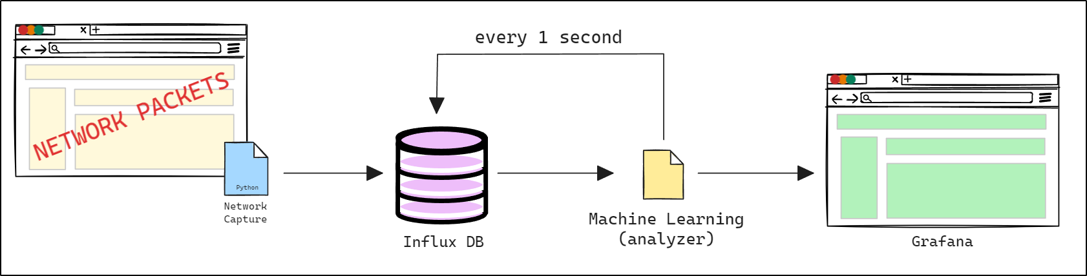
Flow Diagram of Network Traffic Analysis

